Slide 1

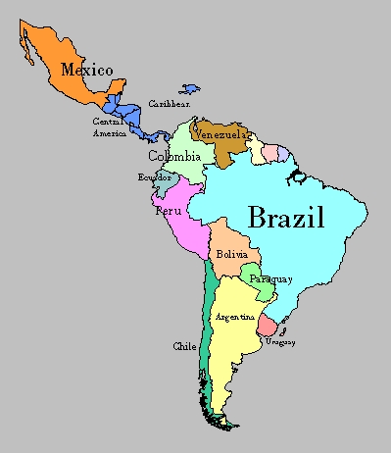
Latin America Tic-Tac-Toe
Choose three projects in a row to show what you know about
Latin America!
Brochure/Pamphlet Must be a three-fold pamphlet. Include pictures and written text. Informational text. Write for an audience that is interested in visiting Latin America. | Newspaper Article Must include a picture with caption that supports the article. Include information about Latin America from the readings. Looks like a newspaper. | Folded Quiz Book Paper folded in half with 10 flaps. Must include 10 questions. Questions come from Chapters 7 and 8. Answers must be True/False or Multiple Choice.
Cartoon/Comic Strip Include at least 6 cells. Must have meaningful dialogue about Latin America. Must tell a story about Latin America culture or its history. | Create a Map Use accurate information to create a map of Latin America. Include a compass rose. Include 10 locations in Latin America. | Post Card Front: Include an illustration of the Latin America culture or a place in Latin America. Back: Write a letter to a friend or family member about your “trip” to Latin America and what you learned.
Drawing Create a drawing illustrating one of the ancient Native American civilizations. Must have a title and brief description of what you drew. | Bulletin Board Display Fits within designated space on bulletin board. Includes at least 10 details about Latin American history, culture, or geography. Must have at least 2 different elements (poster, questions, etc.) One element of poster must be interactive to engage the reader. | Advertisement Include a slogan for your advertisement. Illustration or picture of the item or service. If appropriate, include price. Must be an item or service that would be popular in Latin American culture.

